Slide 1
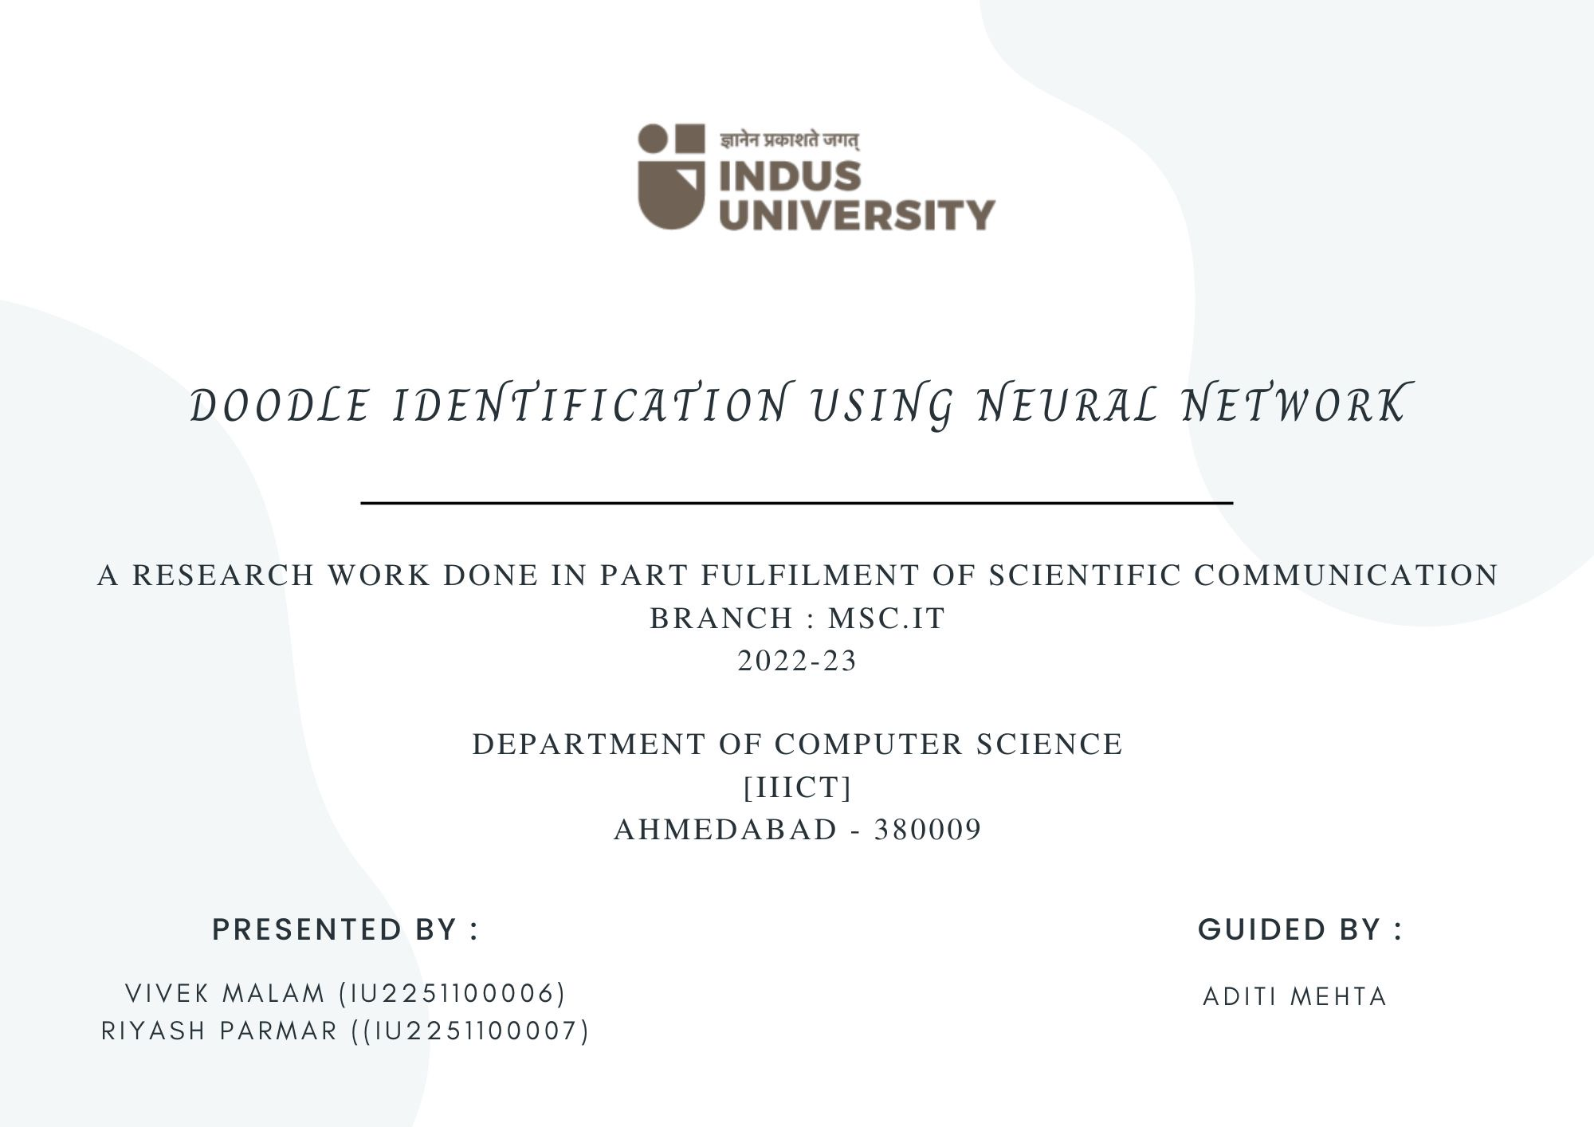

Slide 2
Doodle Identification using Neural Network

Slide 3
Introduction:
An artificial neural network (ANN) usually called neural network. It can be considered as a resemblance to a paradigm which is inspired by biological nervous system. In network the signals are transmitted by the means of connections links. The links possess an associated way which is multiplied along with the incoming signal. The output signal is obtained by applying activation to the net input (NN) are one of the most exciting and challenging research areas.
A neural network is made up of vertically stacked components called Layers. Each dotted line in the image represents a layer. There are three types of layers in a NN-
Input Layer
Output Layer
Hidden Layer

Slide 4

Introduction:
In machine learning, backpropagation is a widely used algorithm for training feedforward neural networks. Generalizations of backpropagation exist for other artificial neural networks, and for functions generally. These classes of algorithms are all referred to generically as "backpropagation".
1
0101010101010
0101010101010
0101010101010
0101010101010
0101010101010
0101010101010

Slide 5
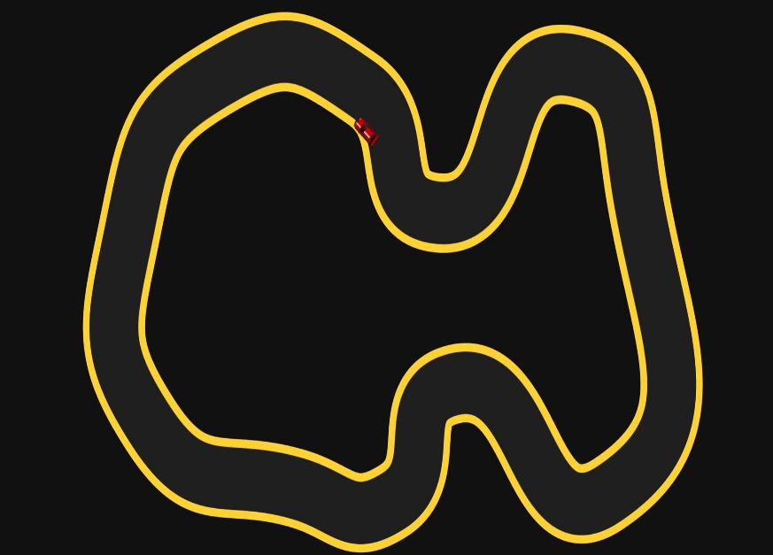
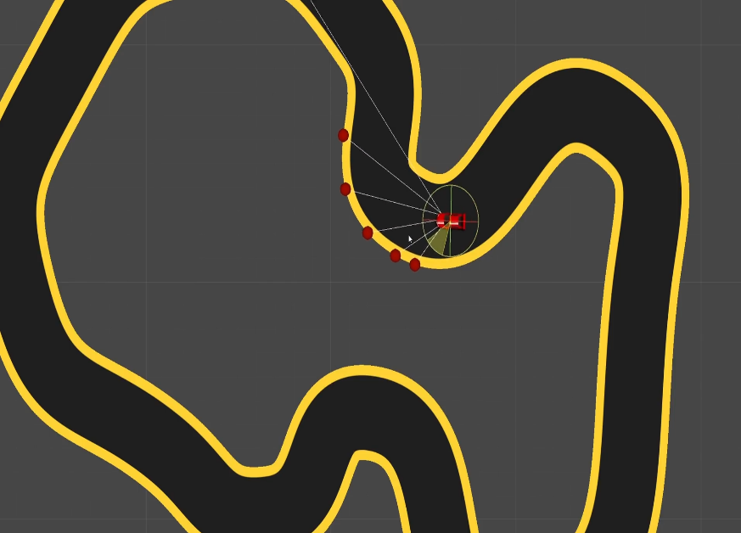
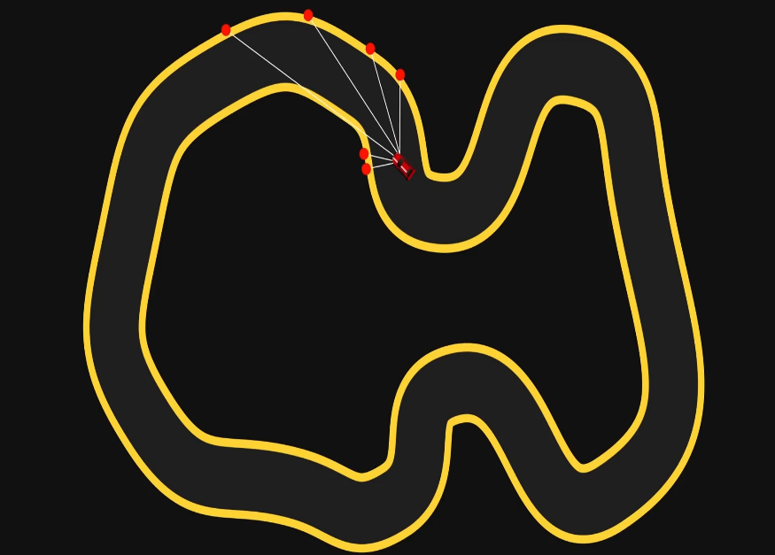
Introduction:
Teaching my computer to recognize various Digits and Doodles now there are all sorts of techniques.
For Example :- So here we have a little two-dimensional car with some sensors that attack the distance to the edge of the road and these edges get fed into a neural network which then tells the car which way to steer of course it's completely hopeless at first but if we let a bunch of them compete and then select the top view that drove the furthest to clone with some random mutations to their networks and then let those compete and so on we eventually get a car that's able to drive around happily on its own.

Slide 6
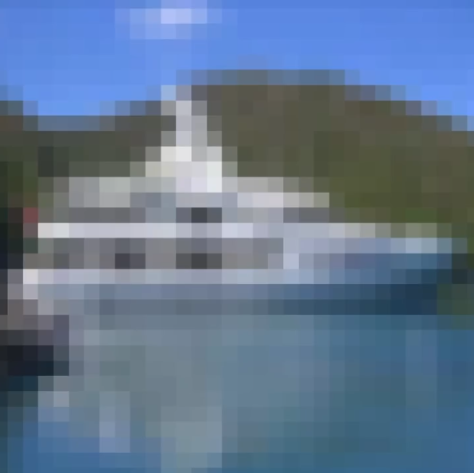
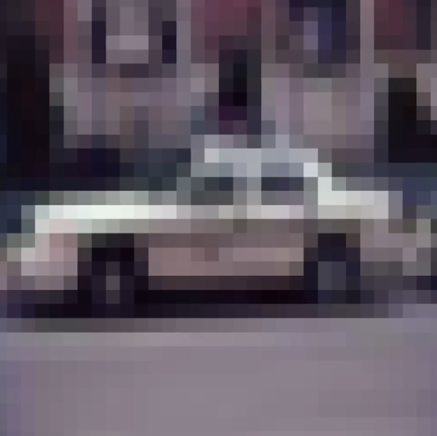
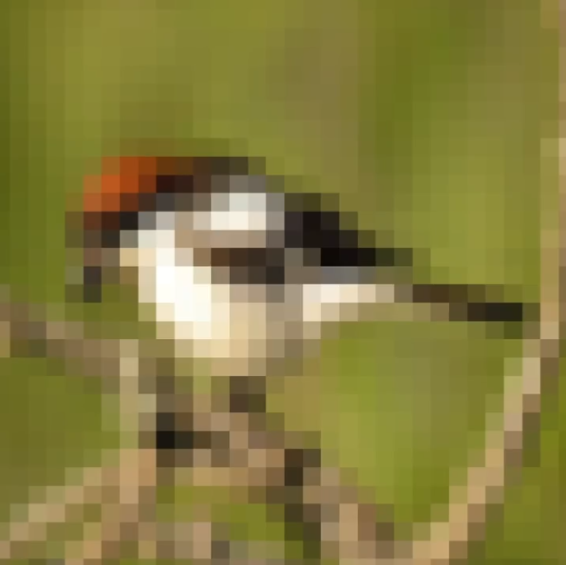
Introduction:
Training a network to identify handwritten digits & I'd like to try trainer to recognize Doodles of 10 different objects such as helicopters, umbrellas, octopuses and windmills.
Actually we could even try one last thing after that which is attempting to identify these little color images again of 10 different things this time from Cars to cats and birds to boats this is obviously quite a leap up in complexity though so if it proves too baffling for our simple Network then we'll have to return in the future to upgrade it to something like a convolutional neural network which is supposed to be much better at these kinds of problems.

Slide 7





Content:
Model Prototype
Approach
Chapters
Snap-shots
Research Methodology

Slide 8
Research Methodology
-Literature Survey
Model Prototype
Approach
Chapters
Snap-shots
Research Papers

Slide 9

Model Prototype
Requirements
Model Used(Spiral)
Features & Scope
Model Experiments
Test Results
Approach
Research Methodology
Chapters
Snap-shots

Slide 10
Chapters
Chapter 1 [Understanding Concept]
Chapter 2 [Programming The Network]
Chapter 3 [Formulating Core Logic]
Chapter 4 [Backpropagation]
Model Prototype
Approach
Research Methodology
Snap-shots

Slide 11
Approach
Model Prototype
Analysis & Interpretation of data
Suggestions / Recommendation
Diagrams
Snap-shots
Chapters
Research Methodology

Slide 12
Snap-shots
Concept Arts
Prototype 1[Digits]
Prototype 2[Doodles]
Prototype 3[Cifar10]
User Interface
Ongoing Dev-Pics
Model Prototype
Approach
Chapters
Research Methodology

Slide 13
Research Paper - 1
Research Methodology

Slide 14
CLASSIFICATION OF PLANT LEAF DISEASE IMAGES USING DEEP CONVOLUTIONAL NEURAL NETWORK
The identification of plant leaf disease is most significant to increase crop yield and growth.
In this research, three different augmented plant leaf disease classification datasets are developed to detect plant leaf diseases.
Results concludes that the combination of several image augmentation techniques based datasets gives better accuracy then a single & non augmented dataset.
To overcome the combination of several images our aim is to divide a single image into pixels so that with the use of backpropagation its enhance the ability to be more specific curve points and provide more accurate results.
From the basic we train a machine with digits then doodles and finally an image with colored pixels. Which can be identified by the machine in the form of prediction to the images that fed in with similarities.
Research Methodology

Slide 15
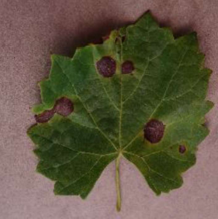
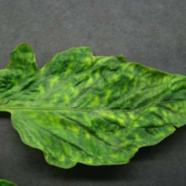
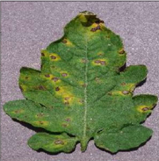
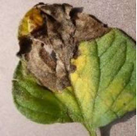
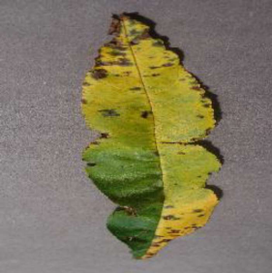
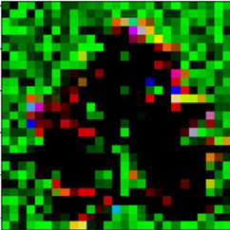
Research Methodology

Slide 16
Research Paper - 2
Research Methodology

Slide 17
SEMI-SUPERVISED NEURAL NETWORKS FOR CHANGE DETECTION OF REMOTELY SENSED IMAGES
Change detection from remotely sensed images is a process for finding out changes in a land cover over time by analyzing remotely sensed images of that particular geographical area at different times.
If changes can be detected in timely manner then early detection of natural hazards and climate change, damage assessment, rehabilitation become easy.
Results conclude that the proposed approaches have an edge over the other state-of-the-art techniques for change detection when a few patterns are available.
Therefore with the use of convolutional neural network that remotely sensed images can be predict in more complex scenarios.
If a machine can identify complex doodles and the pixel images then it can be capable to identify the change detection of remotely sensed images in more precise and effective way.
Research Methodology

Slide 18
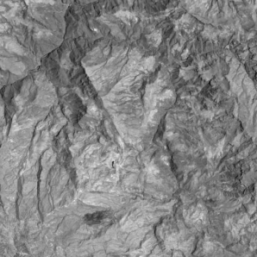
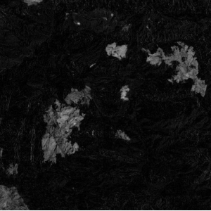
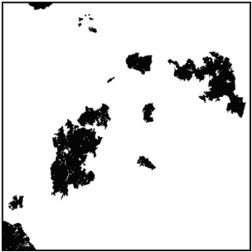
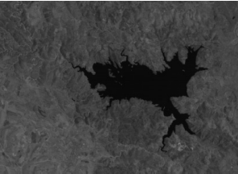
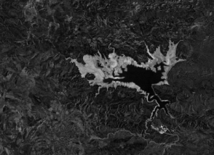
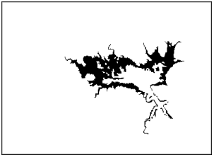
Research Methodology

Slide 19
Research Paper - 3
Research Methodology

Slide 20
CLASSIFIACTION & DETECTION OF SYMBOLS IN ANCIENT PAPYRI
( Egyptian Papyrus )
The advantage of powerful image processing and machine learning tools has generated opportunities for more automated and efficient paleography.
In this work, methods were developed to automate aspects of the transcription process of ancient papyri.
For the creation or extension of a dataset containing such symbols by automatically cropping the symbols using the proposed symbol extractor and then manually finding false positive and false negatives.
The deep learning techniques and convolutional neural networks are frequently used for tasks involving images, as they exploits the correlations between neighboring pixels.
Till now it uses the ANN, if it did with the CNN the accuracy of detection of symbols and differentiate to other sculpting languages from the ancient times.
Research Methodology

Slide 21
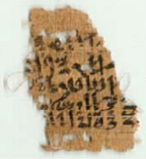
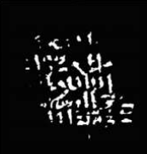
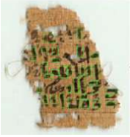
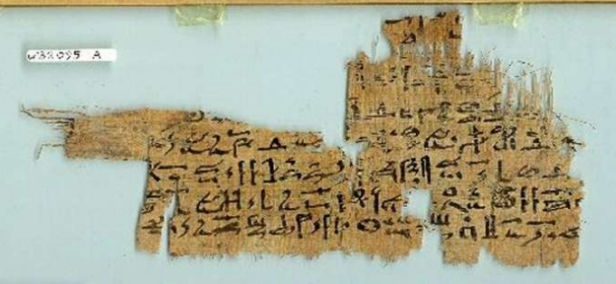
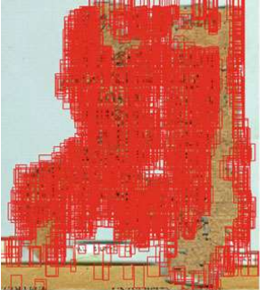
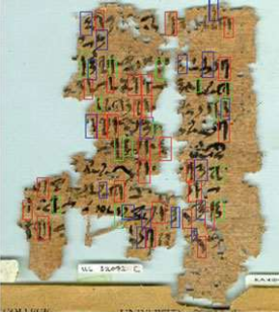
Research Methodology

Slide 22
Research Paper - 4
Research Methodology

Slide 23
COLORIZATION OF BLACK AND WHITE IMAGES USING DEEP NEURAL NETWORK
Colorization of grayscale images has become a more researched area in the recent years, thanks to the advent of deep convolutional neural networks.
Generally, the idea of coloring a grayscale image is a task that is simple for the human mind, we learn from an early age to fill in missing colors in coloring books, by remembering that grass is green, the sky is blue with white clouds or that an apple can be red or green.
To implement it, we propose and compare two distinct convolutional neural network architectures trained under various loss functions. We aim to compare each variant based on results obtained as individual images and videos.
Using the right loss function and color representation, we have shown that the method is capable of producing a possible and vibrant colorization of certain parts of individual images even when applied to a moderately sized dataset that has properties which make it harder to colorize than natural images, but does not perform as well when applied to video sequences.
Research Methodology

Slide 24
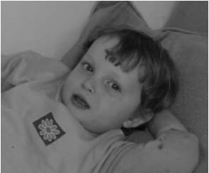
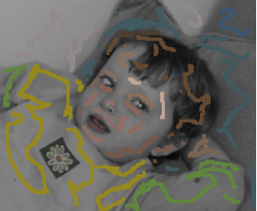
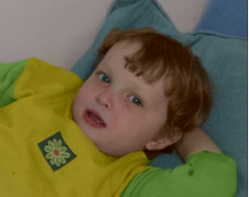
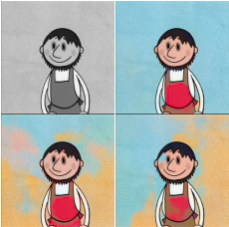
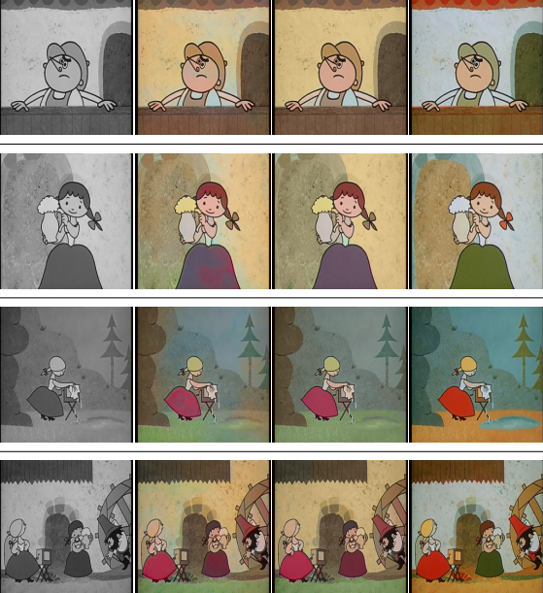
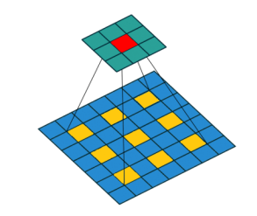
Research Methodology

Slide 25


Requirements :
Our prototype is developed in the Unity game engine using C# programming technology.
Game Engine :
Programming Language :
Others :
ShaderLab
HLSL
Model Prototype

Slide 26
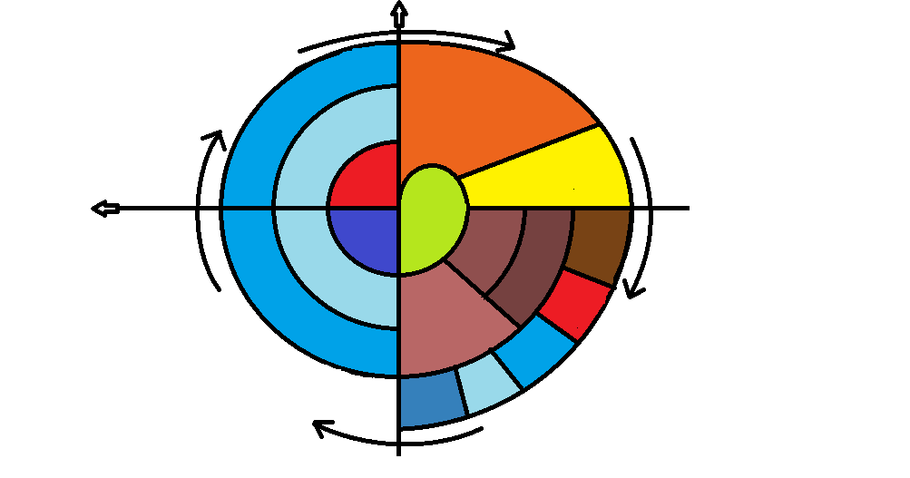
Model used :
Cumulative Cost
progress
Identify
&
Resolve Risks
Determining
Objectives
Risk Analysis
Require-
ments
plan
Prototype
[1-2-3]
Review
Concept
Of
Require-
ments
Model Prototype
Concept
Of
operation
Detailed
Design
Development
plan
Draft
Verification
&
Validation
Code
Test
plan
Plan the
Next Iteration
Integration
Development
&
Testing
Test
Release
Implemen-
tation
Spiral Model…

Slide 27
Why we are using Spiral Model :
The spiral model enables gradual releases and refinement of a product through
each phase of the spiral as well as the ability to build prototypes at each phase.
The most important feature of the model is its ability to manage unknown risks
after the project has commenced.
Model Prototype
Also :
The spiral model combines the idea of iterative development with the systematic, controlled aspects of the waterfall model. This Spiral model is a combination of iterative development process model and sequential linear development model i.e. the waterfall model with a very high emphasis on risk analysis. It allows incremental releases of the product or incremental refinement through each iteration around the spiral.

Slide 28
Features :
Used 2 different datasets Cifar 10 & Minst.
Predefined doddles are trained with the similar kind of patterns.
It shows the % rate of doodle/digit it identifies.
Model Prototype
Model is capable to handle complex patterns.
Scope :
Model is limit to only pre-trained doodles & digits.
Sometimes backpropagation algorithm fails to identify the
patterns.
Few Dark Cifar 10 dataset images are not recognize by model.

Slide 29
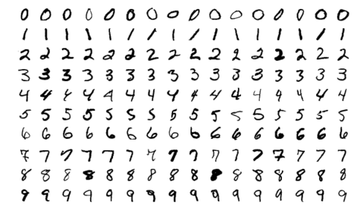
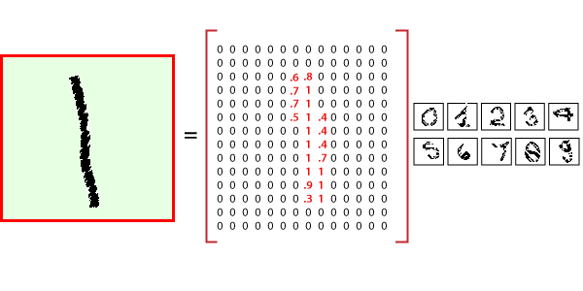
Model Experiments :
MNIST Database – Digits
The MNIST database is a large database of handwritten digits that is commonly used for training various image processing systems.
The MNIST database contains 60,000 training images and 10,000 testing images.
Model Prototype

Slide 30
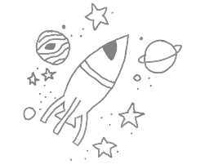
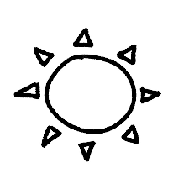
Model Experiments :
Doodles
Doodles are simple drawings that can have concrete representational meaning or may just be composed of random and abstract lines or shapes, generally without ever lifting the drawing device from the paper, in which case it is usually called a scribble.
Model Prototype

Slide 31
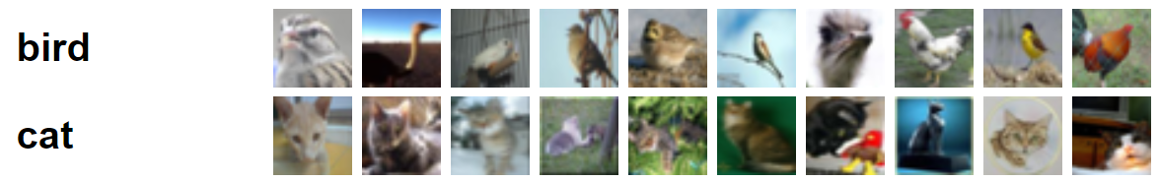
Model Experiments :
Cifar-10 Dataset
The CIFAR-10 dataset consists of 60000 32x32 color images in 10 classes, with 6000 images per class. There are 50000 training images and 10000 test images.
The dataset is divided into five training batches and one test batch, each with 10000 images. The test batch contains exactly 1000 randomly-selected images from each class. The training batches contain the remaining images in random order, but some training batches may contain more images from one class than another. Between them, the training batches contain exactly 5000 images from each class.
Model Prototype

Slide 32
Test Results :
Mnist Database - Digits
Sometimes it Identifies 1 as digit 7 because of shape.
Mirror numbers/rotated numbers are creating complexity.
Doodles
Few minor changes in drawing results different output.
Unpredictable drawings has unknown random output.
Cifar-10 Dataset
Many times it cant predictable because of colour seizure.
Dark shaded images are not recognized easily.
Model Prototype

Slide 33
Chapter 1
[ Understanding Concept]
Chapters
Concept
The Decision Boundary
Weight & Biases
Hidden Layers

Slide 34
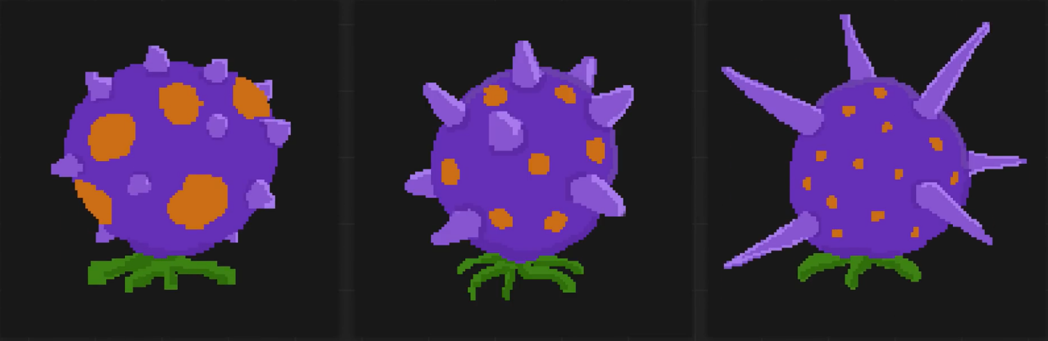
Chapter 1 [ Understanding Concept ]
Concept :-
A peculiar new fruit which is purple and spiky with orange spots.
Strangely though some of them seem to be poisonous fruits and we can see that their appearance varies in two main ways the size of their spots and the length of their spikes.
Chapters

Slide 35
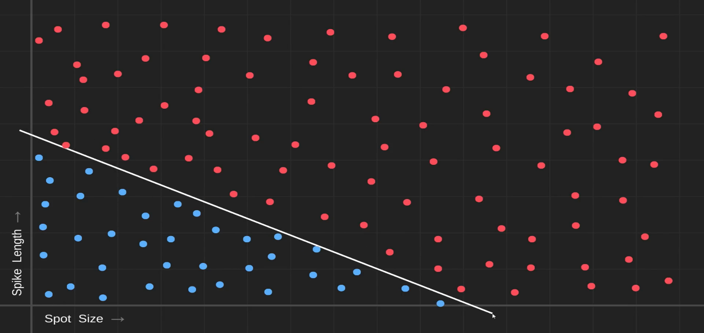
Chapter 1 [ Understanding Concept ]
The Decision Boundary :-
Drawing a graph with the size of the spots on one axis and the length of the spikes on the other then we could collect a bunch of fruit and plot them all on this graph based on those attributes.
If the data turned out looking more like this then we're in business we could draw a little line here called a decision boundary and say that any fruit we find that falls on this side of the boundary is probably poisonous and on the other side it's more likely that!
Chapters

Slide 36
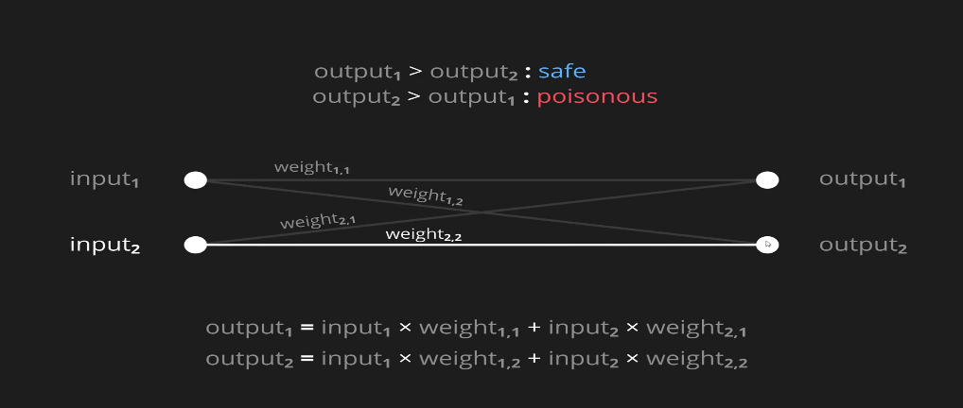
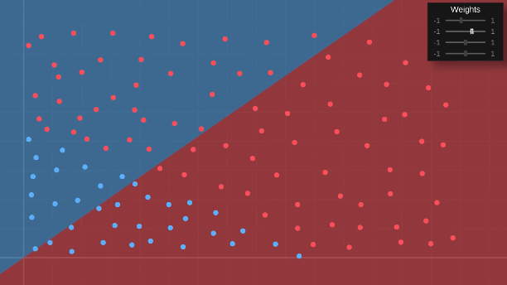
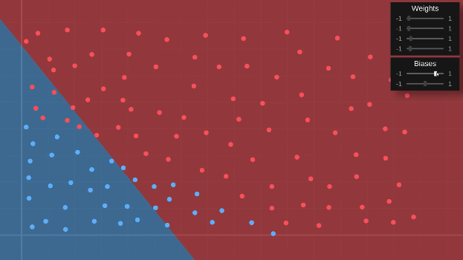
Chapter 1 [ Understanding Concept ]
Weight & Biases:-
We have two inputs in our problem the size of the spots and the length of the spikes and there are also two possible outcomes safe or poisonous the way we'll interpret these is if the first out put has the highest value then we're predicting that it's safe but if the second output has the highest value our prediction is that it's poisonous.
So the actual value of this first output will be equal to the first input multiplied by the weight of its connection plus the second input multiplied by the weight of its connection and it'll be the same story for the second output.
Chapters
Unfortunately no matter what I do I can only get the boundary to essentially rotate around the origin of the graph here when what we need now is to be able to shift it vertically.
Biases
Weight

Slide 37
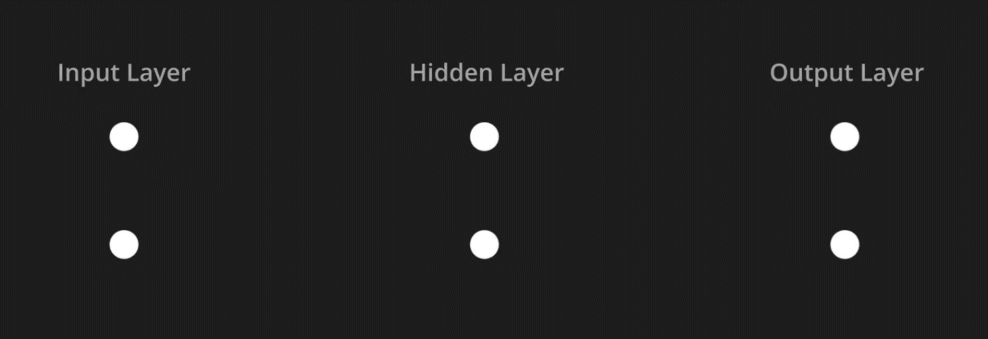
Chapter 1 [ Understanding Concept ]
Hidden Layers:-
Create a new layer that sits in between these in-between layers are known as hidden layers for whatever reason and they can have as many nodes as we like and we could even have multiple hidden layers.
So as our input values get fed forward to the next layer they will be multiplied by their weights as we've seen before and added up with a bias value together creating a weighted input for that node.
Chapters

Slide 38
Chapter 2
[ Programming The Network ]
Chapters
Activation Function
Node Cost, Cost
Gradient Decent Example
Its Learning

Slide 39
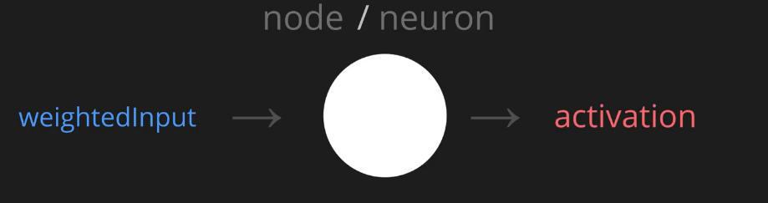
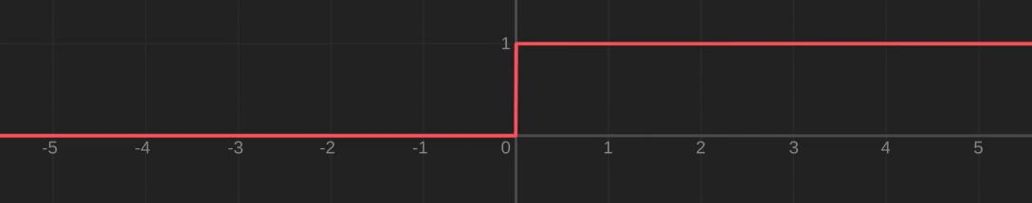
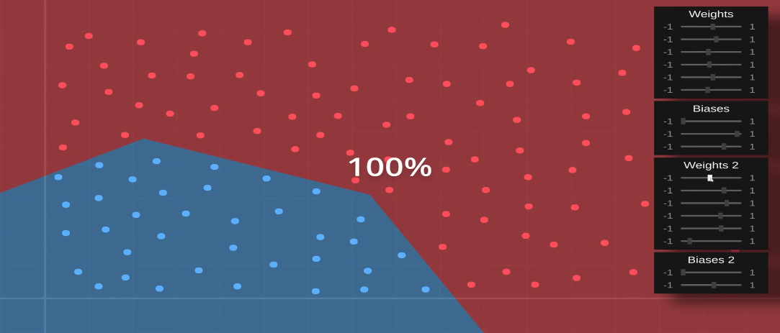
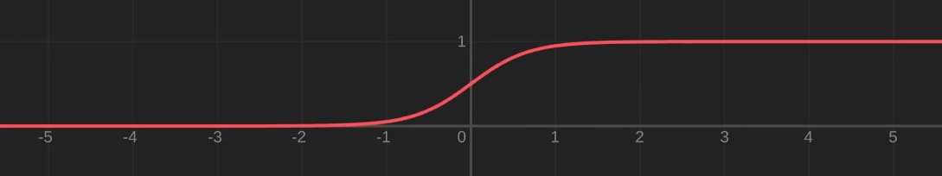
Chapter 2 [ Programming The Network ]
Activation Function:-
A single node in a loose analogy to biological neural networks we can think of this node as a neuron and the weighted input over here as some sort of stimulus.
So the x-axis here shows the weighted input and the y-axis shows the corresponding activation value using an activation function like this should allow us to have more complex decision boundaries.
Chapters

Slide 40
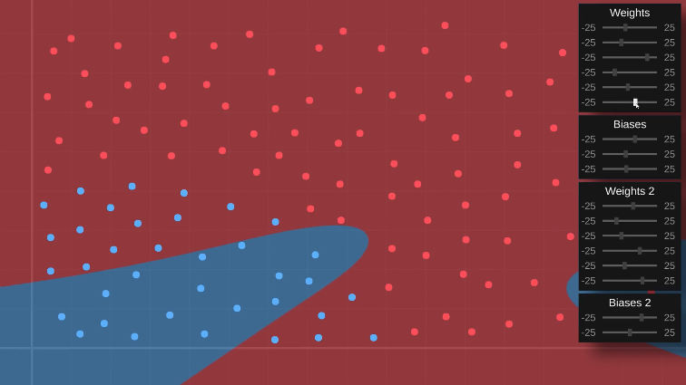
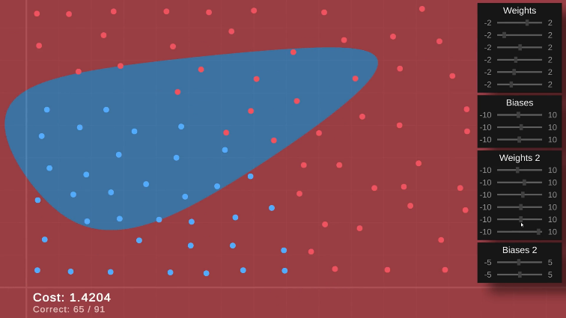
Chapter 2 [ Programming The Network ]
Node Cost, Cost:-
To train this network by hand the goal is for the computer to do it all by itself so that the outputs of our Network again which are now being squished to somewhere between 0 and 1 by our sigmoid activation function.
Node Cost: takes in the output activation value of a single node along with the value we want it to be all it does is calculate the difference between the two and square the result just to make it positive.
Chapters
Cost: takes in a single data point such as one of our fruit and runs its inputs through the network to get the output values using those it then adds up the individual costs of all of the nodes in the output layer to get an overall cost telling us how badly the network is doing for the given data point

Slide 41
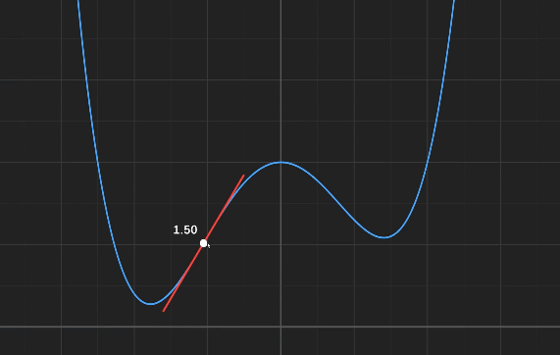



Chapter 2 [ Programming The Network ]
Gradient Decent Example:-
It initializes the input to a random value and then in this learn function it approximates the slope and then simply subtracts the slope value from the input value and this learn rate parameter here just allows us some control over how much the input changes with each iteration.
Here is a random starting value and then we just go press this learn button a bunch of times to repeatedly run the gradient descent algorithm and we can see it's very slowly making its way down the slope till 0.
Chapters

Slide 42


Chapter 2 [ Programming The Network ]
It’s Learning (Slowly):-
It has quickly found this linear boundary which does an okay job of separating a safe from poisonous and the cost is still going down even though not much seems to be happening so let's give it a little bit longer to contemplate.
At last it's managed to perfectly classify the training data so our neural network is learning which is exciting the problem we have now though is that it's excruciatingly slow this is mainly because we're having to run the cost function for every single weight and bias parameter and remember the cost function needs to feed all of the data it's given through the entire network.
Chapters

Slide 43
Chapter 3
[ Formulating Core Logic ]
Chapters
Calculus
The Chain Rule
Some Partial Derivatives

Slide 44



Chapter 3 [ Formulating Core Logic ]
Calculus:-
When the derivative is zero corresponds to where our function has zero slope and where the derivative is negative that's where the function is looping downwards and soon so the derivative is the super helpful thing that tells us the exact slope of our function at any input value.
Its derivative and we can see again how the derivative tells us exactly what the slope will be at any input value or put another way how sensitive the output of the function is to a change in the input.
Chapters
F(x)=x²-3x+4 > [ΔF=f(x + h)-f(x)] > [2x+h-3] > [2x-3]

Slide 45


Chapter 3 [ Formulating Core Logic ]
The Chain Rule:-
A ridiculously simplified Network that has just three nodes connected by two weights like this and let's write out quickly how this works so the input node receives some input value let's call that activation zero and then we calculate the weighted input Z1 for short which is just the input multiplied by the weight plus some bias value next we calculate activation one simply by passing the weighted input into our activation function then we do the same thing to calculate Z2 and finally A2.
Chapters

Slide 46


Chapter 3 [ Formulating Core Logic ]
Some Partial Derivatives:-
The amount of effect that a change to the weight will have on the weighted input depends entirely on the input which is this a value here for example if a is zero then changing the weight would have Zero Effect whereas if a is 10 then changing the weight would have a 10 to 1 effect and so on.
The weighted input changes in response to the input but again if we just look at this equation here we can see that the amount of effect that a change to the input will have on the weighted input is determined entirely by the value of the weight.
Chapters

Slide 47
Chapter 4 [ Backpropagation ]
Chapter 4
[ Backpropagation ]
Chapters
Backpropagation
Digit Recognition
Doodles
Drawing Digits & Doodles

Slide 48


Chapter 4 [ Backpropagation ]
Backpropagation:-
Approach of starting with the output layer and going backwards through the network so that we can keep reusing these node value calculations is known as the backpropagation algorithm and as we can see it's only running each data point through the network once or I guess we could call it twice since it does have to go backwards through the network as well but that's a huge improvement over having to do it for every weight and bias parameter.
Chapters
Takes in a single data point and runs it through the network and if we modified the layer code slightly so that when that happens each layer stores all the information we're going to need like the weighted inputs and soon after that it asks the output layer to calculate the node values.

Slide 49
Chapter 4 [ Backpropagation ]
Backpropagation:-
Update gradients function which takes in the node values and then for each connection it calculates the partial derivative of the cost with respect to the weight of that connection and then uses that to update the gradient also which means that however much the bias changes the weighted input will change by the same amount.
This works is that the first of the new node values here will be equal to the weight of this connection multiplied by the old node value it connects to plus the weight of this connection multiplied by the old node value that it connects to and then as you can probably guess the second new node value will be equal to this weight multiplied by this old node Value Plus this weight multiplied by this alternate value and same thing for our third new node value.
Chapters
After that it just performs our gradient descent step by telling all the layers to apply their gradients and remember they multiply the gradient by the Learn rate when doing that so if we just divide the learn rate by the size of the training batch that'll average out all the gradients that we added together with that our new learning code is complete.

Slide 50


Chapter 4 [ Backpropagation ]
Digit Recognition:-
Classic handwritten digits dataset we have 70,000 images on our hands here all labeled with the correct answer and each of these images is a minuscule 28 by 28 pixels so that's 784 values in total each ranging from black(0) to white(1).
Hopefully the idea makes sense that we can think of each of the images as points somewhere in 784 dimensional space and our Network just needs to figure out which regions of the space each digit tends to hang out in just like it figured out which regions of two-dimensional space the safe and poisonous fruits tend to inhabit.
Chapters

Slide 51


Chapter 4 [ Backpropagation ]
Doodles:-
So I've downloaded a doodle dataset drawn by people from all around the world which comes from the very cool quick draw project.
I've increased the size of the network again and also added some extra hidden layers not for any deep reason I've just been messing around with different settings out of curiosity so I'll leave this to train for a few minutes and by the way I did make the same random transformations to the Doodles as we did with the digits.
Chapters

Slide 52


Chapter 4 [ Backpropagation ]
Drawing Digits & Doodles:-
It's very good at recognizing images from the data set but when I draw my own digits it's like it's never seen a number before. I think what's going on is that all the digits in the data set have been sized and centered in a specific way and I guess the network has come to rely on that being the case.
I have written some code that can rotate well that was more sensitive than I was expecting it can rotate the digits in the data set as well as scale them move them around and add some noise these settings can be applied randomly and I'll tell it to do that for all the images and then we can train a new network on this modified data.
Chapters

Slide 53


Analysis & Interpretation of Data :
Approach
When the learn rate is 1.
When we include momentum.
When testing on sample it shows the accuracy but when adding more layers it creates spikes of random errors.

Slide 54


Analysis & Interpretation of Data :
Approach
When the learn rate is near to 0.
After tuning for specific datasets.
After all the test result is that the learn rate near 0 is highly accurate & viz.
So, when learn rate is slow it learns too better then the learn rate is high.

Slide 55
Suggestions / Recommendations :
Does this model helps to identify the DNA Sequences?
Is your model enough capable to embed on different devices?
Convert your ANN model to CNN ! Its fantastic that your model can learn by predicting by own.
Cifar10 is for images but find something that it can create the black and white videos to colors.
Suppose you convert your C# project to Python project! Is there any chances that your model becomes more strong and accurate.
For future enhancement is your model capable to teach humanoid robots about human languages and to recognize complex patterns.
Approach

Slide 56

Concept Art:
Snap-shots

Slide 57

Prototype 1 [ Digits ]:
Snap-shots

Slide 58

Prototype 2 [ Doodles ]:
Snap-shots

Slide 59

Prototype 3 [ Cifar 10 ]:
Snap-shots

Slide 60
Stakeholders :
Developer Community
Organization
System Analyst
Researchers
Historians
Playgroup Children
Archaeologist
Scientists
Meteorologist (person who forecast the weather)
Graphologist (person who analyses handwriting)

Slide 61
Conclusion :
The model came to an end with a great accuracy and it can honestly defines the patterns which we can train by the lower learn rate as nearest to 0.
But if we slowly move upwards to the learn rate 1 it shows the drastic change on the graph.(it declines because it skips the must include grayscale points).
As we seen in a gradient decent example when the learn rate is slow it slopes down perfectly but if we increase the learn rate it goes randomly to any of the point.
We presented a model that identifies complex patterns (Doodles, Digits, Images) using the Activation, Cost, Derivatives & Backpropation Algorithms.
With the proper use of datasets our model trained to improve the identification of various recognizable doodles, digits & pictures.

Slide 62
Proposed Enhancement :
If trained on a larger dataset, the predictive power of the model would increase and is likely to produce more consistent results.
Using CNN our model gets a rapid boost to identify the images of different objects by its own. Mainly CNN used for image recognition and task that involves the processing of pixel data.
If we bring our model to god mode we can use this model at digital signature, image segmentation & NFT’s.
Models based on conditional generative adversarial networks, as the results they have been able to put together when applied to natural images are quite impressive and allow the user to have more control over the result by adjusting the latent space variable.

Slide 63
Bibliography :
https://shodhganga.inflibnet.ac.in/handle/10603/343160
https://shodhganga.inflibnet.ac.in/handle/10603/369659
https://www.researchgate.net/publication/340493376_Classification_and_Detection_of_Symbols_in_Ancient_Papyri
https://core.ac.uk/download/pdf/151072499.pdf
https://github.com/googlecreativelab/quickdraw-dataset
https://www.cs.toronto.edu/~kriz/cifar.html

Slide 64

Thank You!

